Slide 1
Let’s Tackle SQL

Slide 2
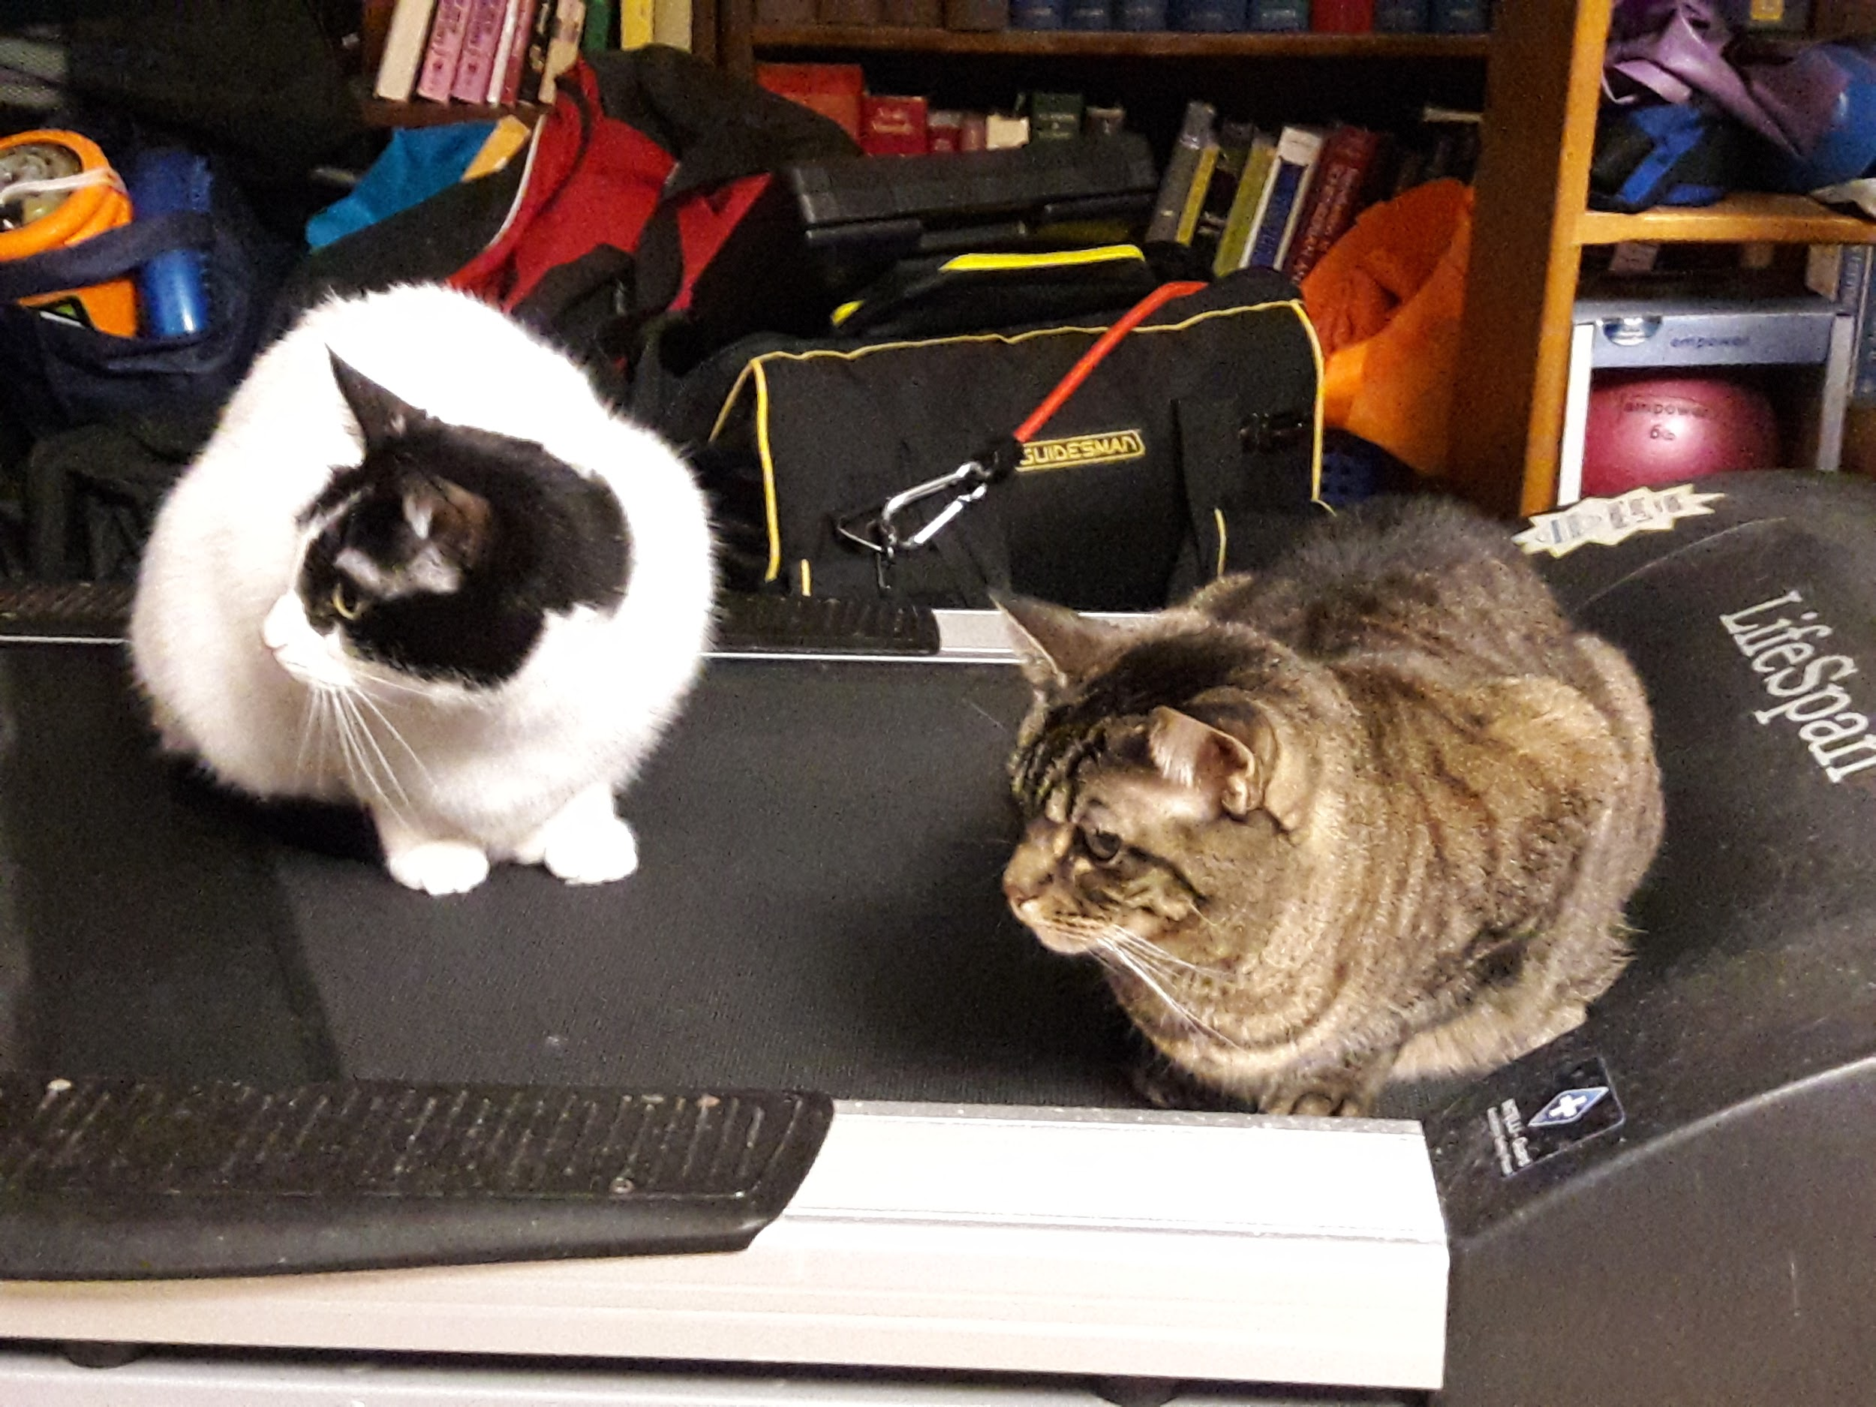
About Me
Self-taught SQL programmer working with SQL Server 10+ years
Full-stack web developer
Enjoy learning new languages and techniques
Runner and musician
Contractor presently with Mayo Clinic

Slide 3
Technical Stack For This Talk
OS: Windows 10
RDBMS (Relational Database Management System): SQL Server 2012
Application: SQL Server Management Studio
Database: AdventureWorks
Language: T-SQL (Transact-SQL)
There are many other RDBMS’, language versions and datasets that can be used for practice purposes on both Windows and macOS.
Versions of SQL vary slightly - once you understand the basics, you will be able to target the differences, just as you would with any other language.

Slide 4
Thinking About The Data You Need
Questions
What kind of data am I looking for?
Do I know what tables this data is in?
Do I need all the attributes or only a portion?
Tips
Imagine tables as containers you can take things out of
Think about how pieces of data may match together
What questions are you trying to answer?

Slide 5

The Materials: FROM
One of the 2 pieces you need to create a simple query
Choose a specific table to review
Can contain JOINs to link tables together
Aliasing your tables for more complex queries

Slide 6

The Swiss Army Knife: SELECT
One of the 2 pieces you need to create a simple query
Allows you to peek inside tables and take a look around
Return a portion of records for review

Slide 7

The Saw: WHERE
Refine your simple query with conditions
Use parentheses to ensure logic is evaluated correctly

Slide 8

The Screwdriver: JOINs
Brings data together from multiple tables
Primary/foreign key relationships make it easier to determine which columns to use
INNER JOIN is the most common => matches data between all the tables in the join

Slide 9
The Screwdriver: JOINs
LEFT (OUTER) JOIN => all of the data from the “left” table, only matching data from the “right” table
RIGHT (OUTER) JOIN => all of the data from the “right” table, only matching data from the “left” table
FULL (OUTER) JOIN => brings back all rows from both tables, filling in missing values with NULLs
There are selected cases where you would not use a JOIN but beware of Cartesian products!

Slide 10

The Wrench: GROUP BY
Allows aggregation of data within the query
Based on the selected fields, changes the granularity of the returned data
Results can be further refined with the HAVING clause, which allows conditional logic on the grouped data

Slide 11
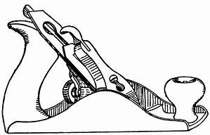
The Planer: ORDER BY
Sorts the returned results
Useful if the results will be further processed as ordered values
Don’t use if you are able to use the dataset unsorted - there is extra processing power used that can cause queries to run longer than needed

Slide 12

The Clamp: UNION
Allows combinations of returned result sets to be viewed as a single set of results
Variations
UNION => returns distinct rows between the 2 sets
UNION ALL (recommended) => returns sets with no further operations taken
Other advanced variations outside the scope of this talk

Slide 13

Resources
Transact-SQL Documentation (SQL Server 2017):
https://docs.microsoft.com/en-us/sql/t-sql/language-reference?view=sql-server-2017
The Guru’s Guide to Transact-SQL:
https://www.amazon.com/Gurus-Guide-Transact-SQL-Ken-Henderson/dp/0201615762/
SQL Shack’s List of Top SQL Server Blogs:
https://www.sqlshack.com/sql-server-blogs/
(I recommend SQL Authority, MSSQLTips, and Simple Talk (RedGate))
Any friendly DBA or SQL guru - contact me anytime

Slide 14



Kristen Kinnear-Ohlmann
kristenkinnearohlmann
@kinnear_ohlmann
kristenkinnearohlmann

Slide 15
Questions?

